Slide 2


Gabe Maentz
Work @ RiverPointTechnology.com
Tweet @ gmaentz
Blog @ Maentz.net
Co-Founder @ vBrisket.com

Slide 3
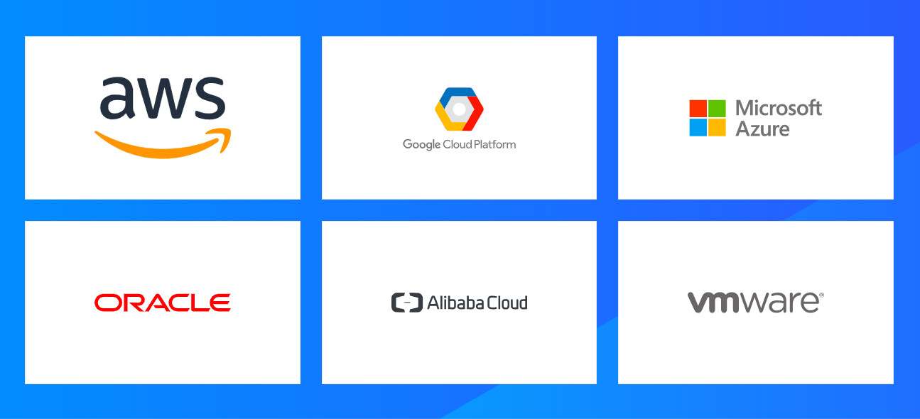
Customers are Adopting Cloud
Notes:
All major cloud providers (private and public) were present at the conference – many with new announcements in how they are integrating, and in many cases using the HashiCorp products within their ecosystem.
I know there are a number of folks in the audience utilizing VMware in their private data centers…..can I get a quick show of hands?
How about AWS users? GCP? Azure?
Oracle / Allibaba
Any not represented on this slide?

Slide 5
But the Reality is ….. Enterprises are Running Data Centers
Notes:
All major cloud providers (private and public) were present at the conference – many with new announcements in how they are integrating, and in many cases using the HashiCorp products within their ecosystem.
I know there are a number of folks in the audience utilizing VMware in their private data centers…..can I get a quick show of hands?
How about AWS users? GCP? Azure?
Oracle / Allibaba
Any not represented on this slide?

Slide 6
And those Enterprises…. are running VMware
“Most of the World is virtualized running VMware”
Andy Jassy
CEO Amazon Web Service
AWS re:Invent 2018
Keynote
Notes:
All major cloud providers (private and public) were present at the conference – many with new announcements in how they are integrating, and in many cases using the HashiCorp products within their ecosystem.
I know there are a number of folks in the audience utilizing VMware in their private data centers…..can I get a quick show of hands?
How about AWS users? GCP? Azure?
Oracle / Allibaba
Any not represented on this slide?

Slide 7
But Maybe Not That Securely
How many VM admins utilize the same root password for all of their ESXi servers?
When was the last time you updated the root password for your ESXi servers?
Do old VM admins who have left your organization still have your root passwords memorized?
Notes:
All major cloud providers (private and public) were present at the conference – many with new announcements in how they are integrating, and in many cases using the HashiCorp products within their ecosystem.
I know there are a number of folks in the audience utilizing VMware in their private data centers…..can I get a quick show of hands?
How about AWS users? GCP? Azure?
Oracle / Allibaba
Any not represented on this slide?

Slide 8
Multi-Cloud
It would really be helpful if I could use the same software and tools that I have invested all of this time and resource into to manage my infrastructure on-premises the last number of years but be able to use it to run my infrastructure on public cloud infrastructure.

Slide 9
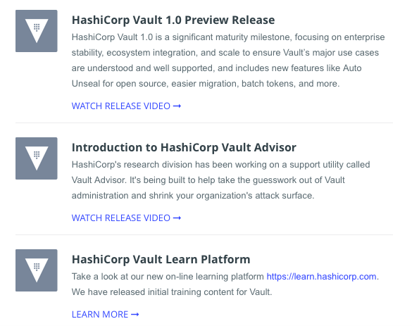
Vault
Automatic Usealing with Key Management Services
Vault Advisor
Vault Learn
Kubernetes Support
Notes:
HashiCorp Vault is a secrets management service designed to grant access to databases, cloud APIs and other services dynamically based on the application requesting access.
It’s a great tool for scaling the management and consumption of secrets within both cloud and on-premise environments.
Automatic Unsealing of Vault has been added to the open source release of the product in Version 1.0, after previously only being available in Vault Enterprise.
Typically, Vault requires a customisable number of users to provide their own keys to ‘unseal’ Vault – allowing access to the secrets storage.
With Automatic Unsealing, the key management services within cloud providers like AWS Key Management Service (KMS) can be used to take custody of these keys. And Vault can automatically unseal its secrets removing the need for operators to intervene.
Advisor is being designed to monitor usage patterns for services talking to Vault and to notify the Vault user when a service has been granted permissions in excess of what it is actually using. By comparing the Vault Access Control List granted to a service and the actual secrets that it is requesting, a differential is calculated between the two – showing what access is unused.
This means that Vault will make it easier to use the principle of least privilege for your Vault Access Control Lists, giving suggestions for what access can be removed.
Vault 1.0 also makes the auto unseal capability formerly part of Vault Enterprise available in open source. This allows users to more easily automate the provisioning and lifecycle of Vault without a manual unseal process.

Slide 10
Tools of the Trade
vSphere Client
PowerCLI
Python

Slide 11
Evolving Secrets Management
Manual
Characteristics: Manual, Use the UI to update the password
Pain Points: Time Consuming, Password is known by one admin, shares it with others
Semi Automated with single password for all hosts
Characteristics: Starting to use tools like PowerCLI, etc to update the password
Pain Points: Password is known by one admin, shares it with others, password is updated only when administrator has time to run the script, limited versioning
Automated with single password for all hosts
Characteristics: Automated PowerCLI, possibly REST API to rotate passwords
Pain Points: Password is known by one admin, shares it with others
Fully Automated
Characteristics: Automated PowerCLI, REST API to rotate passwords, unique password for all hosts, changed dynamically and still allows for manual revoke and updates

Slide 12
PowerCLI
One Liner

Slide 13
Discover Your ESXi Servers
One Liner

Slide 14
Store the Credentials for ESXi Hosts
One Liner

Slide 15
Update the Credentials of your ESXi Hosts
One Liner
Version Control

Slide 16
Provide Unique Credentials for each ESXi Host
One Liner

Slide 17
Log When Credentials are Read/Changed
One Liner

